Slide 1

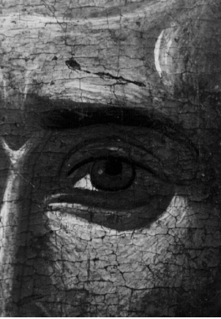
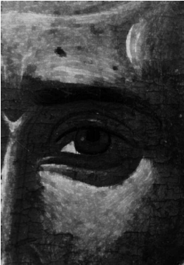
भारतीय सूचना प्रौद्योगिकी संस्थान नागपुर
Indian Institute of Information Technology Nagpur
An Institution of National Importance By An Act of Parliament
Title:
Hybrid Framework for Craquelure Detection and Virtual Restoration in Digitized Paintings
Presented by:- Keshav Tak(BT23ECI039)
Kaushik Kumar(BT23ECI044)
Parth Chaudhary(BT23ECI045)
Shreyas Khare(BT23ECI058)
Presented to:- Dr. Tapan Kumar Jain

Slide 2
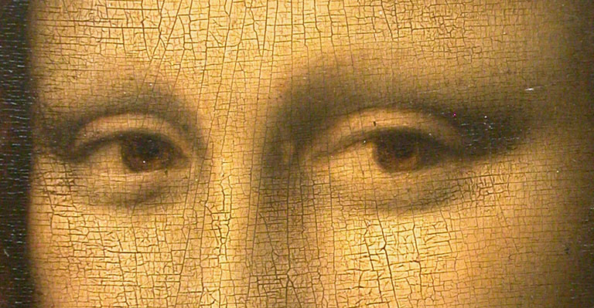
Why Restoration is Needed?
Old paintings develop cracks due to:
Aging
Drying of paint
Mechanical damage
Cracks reduce beauty and image quality
Manual restoration is expensive and risky
Digital restoration is safe and non-destructive

Slide 3
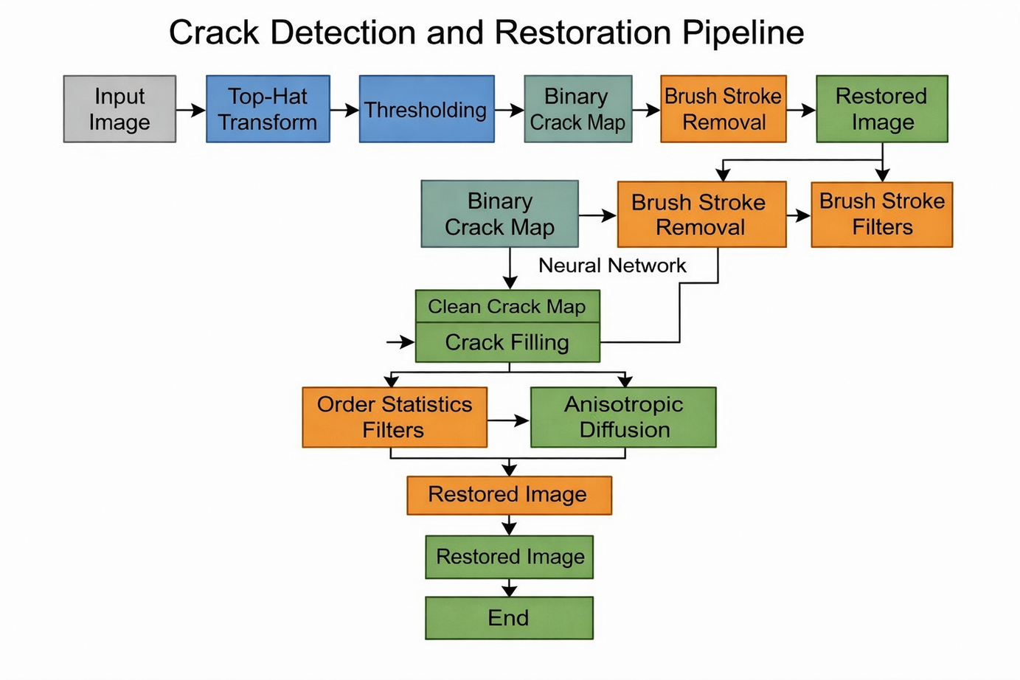
Objective
The paper proposes a complete system having 3 stages:
Crack Detection
Separation of brush strokes from cracks
Crack Filling / Image Restoration

Slide 4
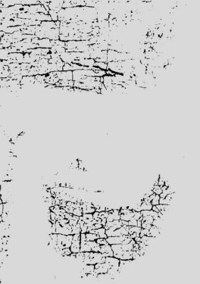
Crack Detection Method
Stage 1: Crack Detection using Morphological Top-Hat Transform
Cracks are dark thin lines
They behave like local minima in image intensity
We are using Top-Hat Transform
Thresholding is applied after transform
T(f)=f−(f∘b)
Where:
f = image
b = structuring element
∘ = opening of the original image

Slide 5
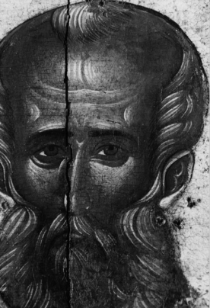
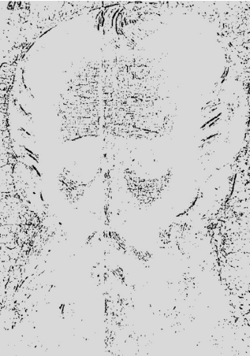
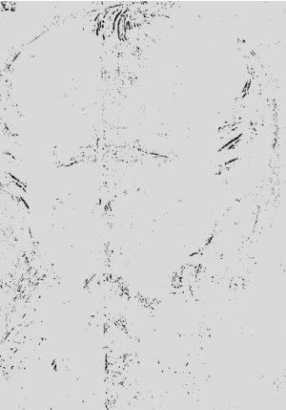
Problem: Brush Strokes Misdetected
Sometimes dark brush strokes look similar to cracks.
Examples:
Hair
Fine painting lines
Borders
So system needs separation.

Slide 6
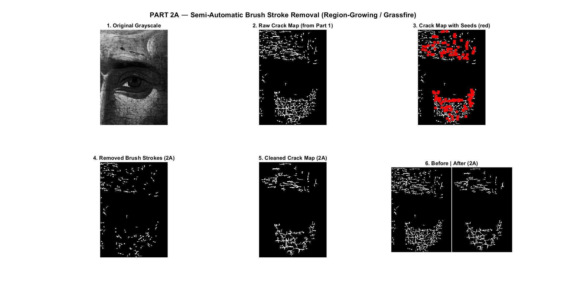
Separation Techniques
Two Methods Used:
1. Semi-Automatic Region Growing
User selects true crack seeds
Algorithm grows connected crack regions
2. MRBF Neural Network
Uses:
Hue
Saturation
To classify:
Crack pixels
Brush stroke pixels

Slide 7
Crack Filling Methods
After detection, missing pixels are restored using:
1. Order Statistics Filters
Median Filter
Weighted Median
Trimmed Mean Filter
2. Controlled Anisotropic Diffusion
Orientation Sensitive Anisotropic Diffusion

Slide 8
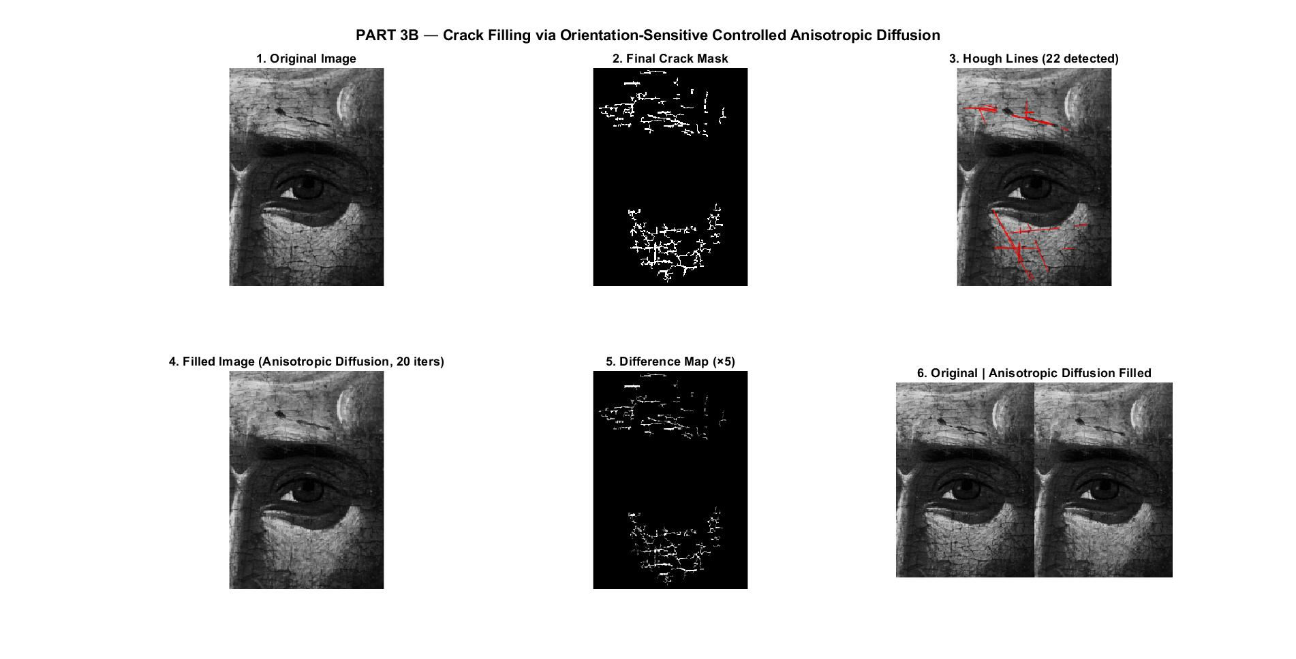
Anisotropic Diffusion
This method:
Smooths crack area
Preserves edges/details
Uses crack direction
Fills only perpendicular to crack
∂t/∂I​=∇⋅(c(x,y,t)∇I)

Slide 9
Results
Step wise results are as follows :

Slide 10
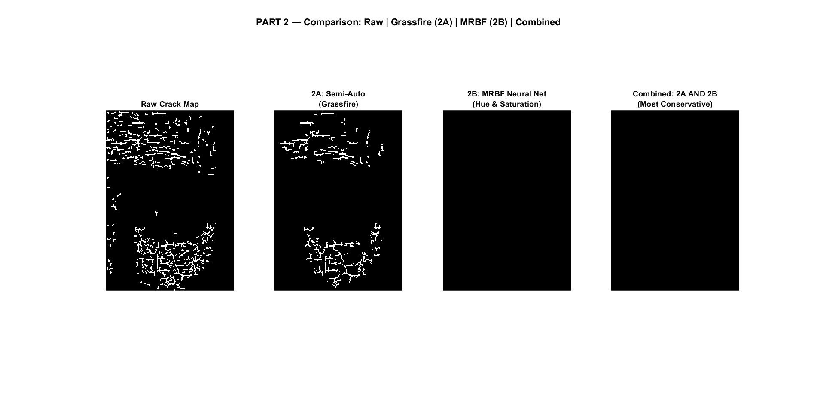

Slide 11
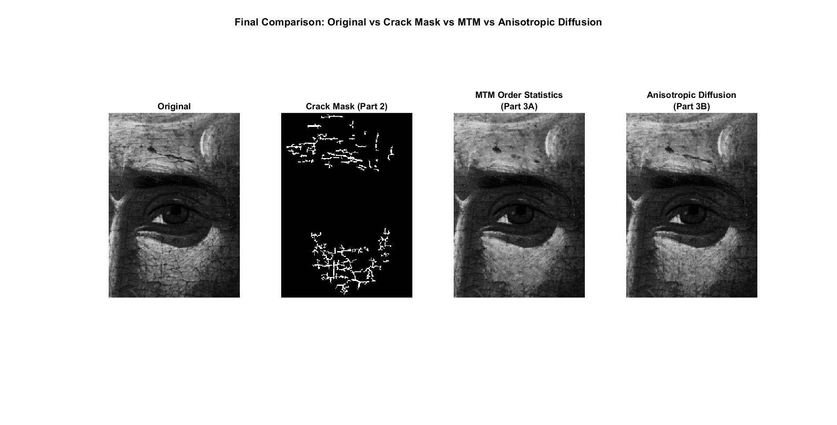

Slide 12
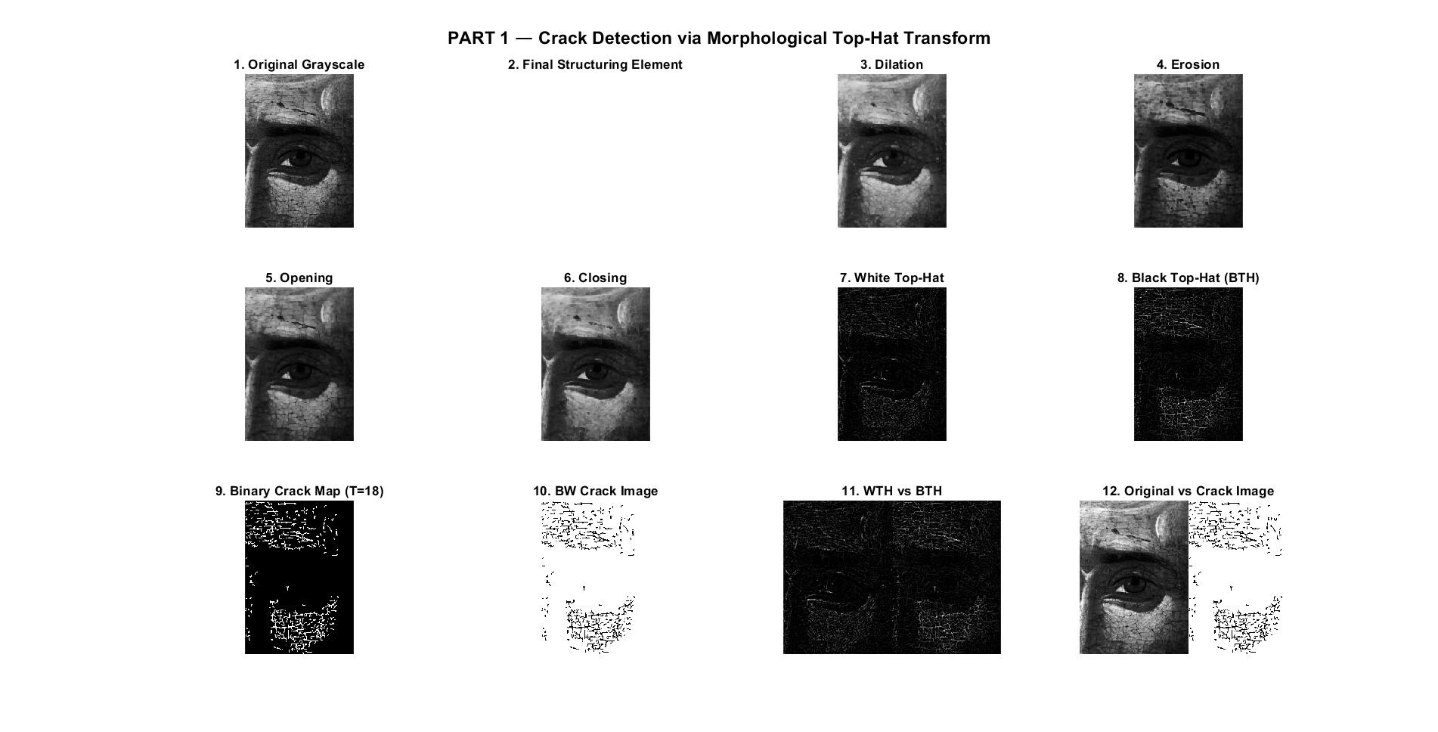

Slide 13
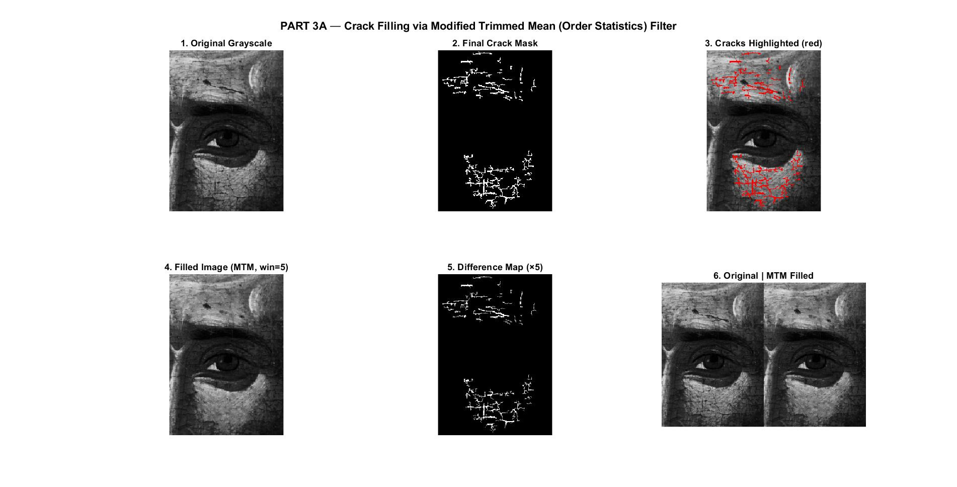

Slide 14
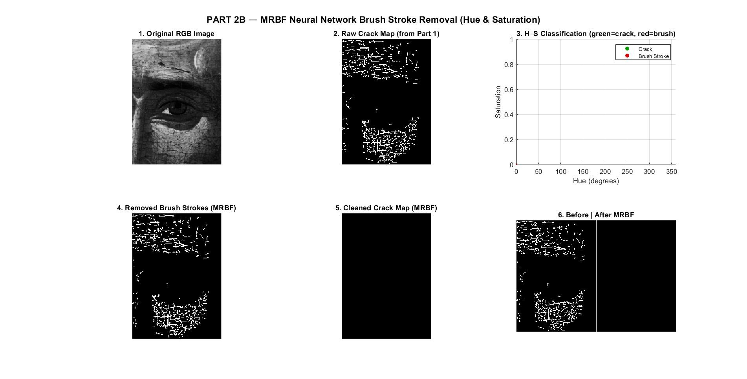

Slide 15


Slide 16
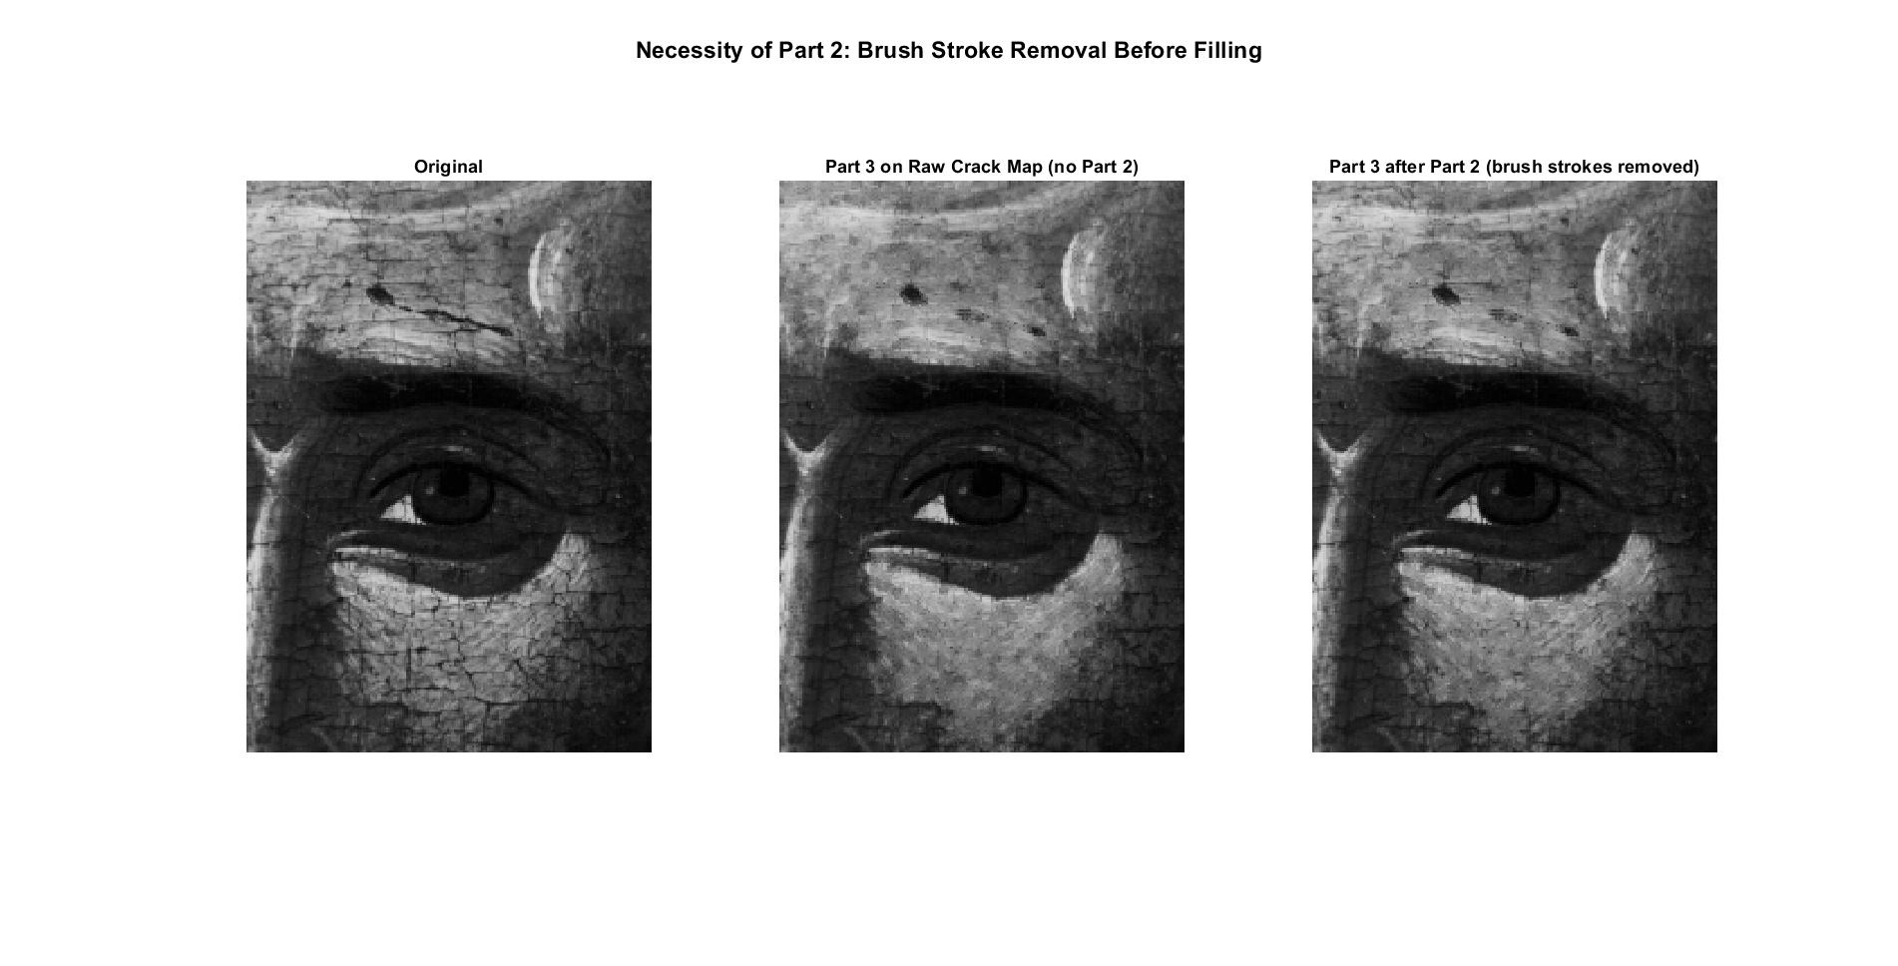

Slide 17
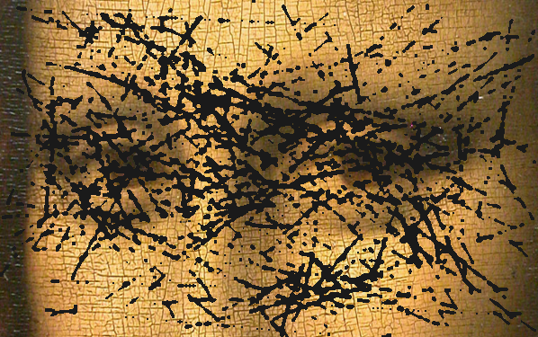
Modern Approach (Cuch-Guillén et al., 2026)
Uses morphological Top-Hat + SegFormer transformer for crack detection
Synthetic crack generator (Bézier curves) creates training data — no manual labeling needed
Orientation-sensitive Anisotropic Diffusion for inpainting (50 iterations vs 20)
Fully annotation-free pipeline

Slide 18
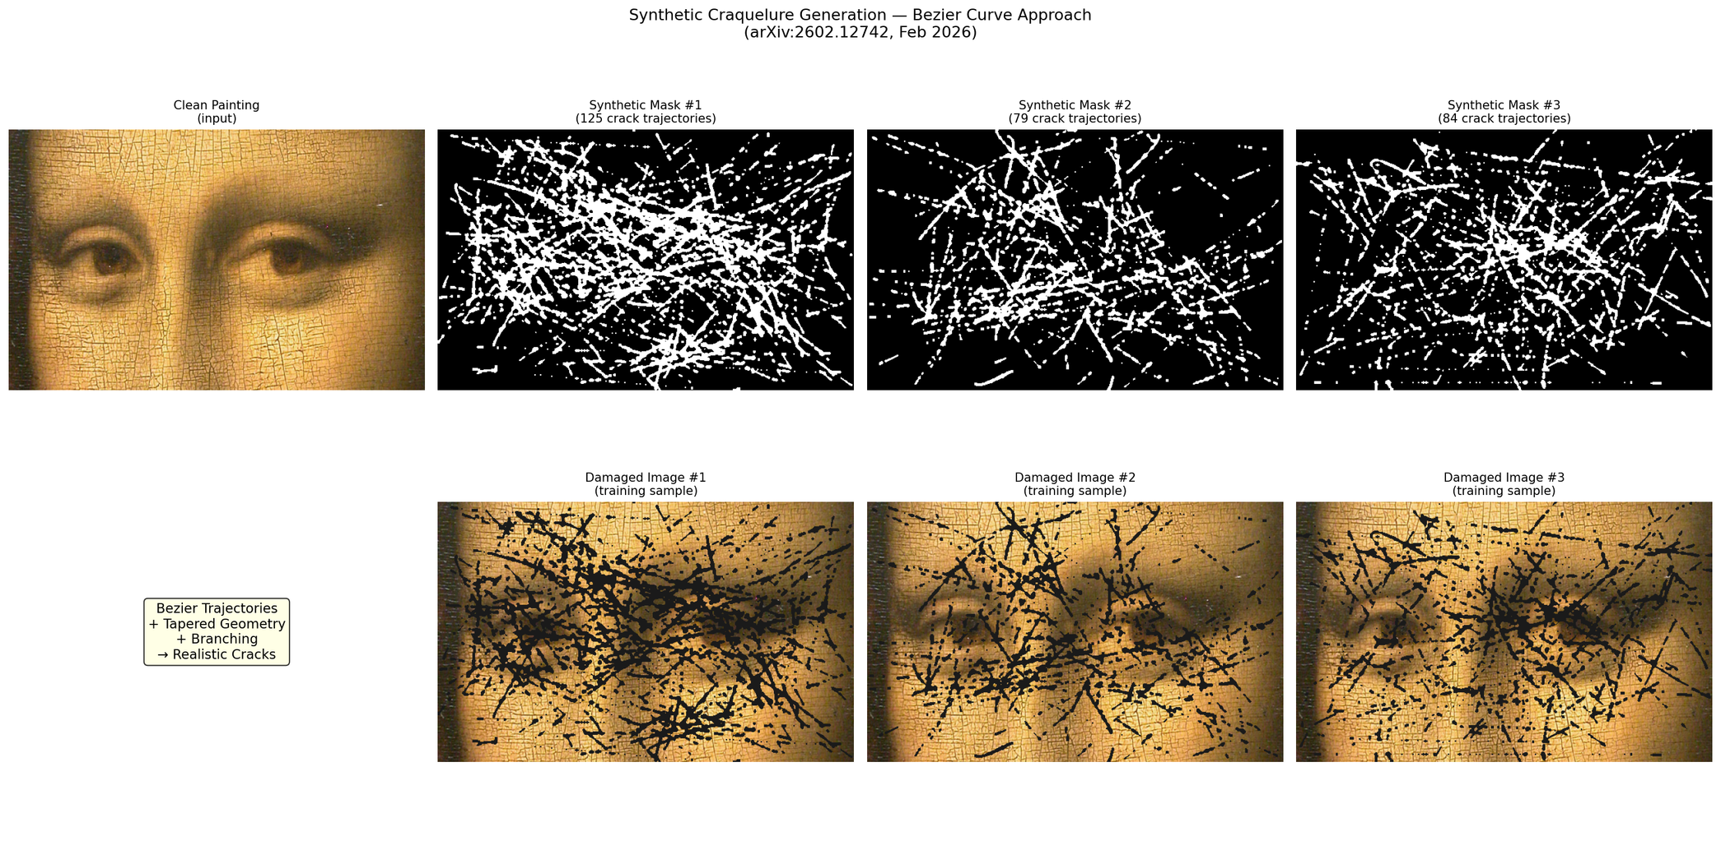
Fig. Bézier crack generation

Slide 19
Modern Method Results
Same top-hat detection as classical baseline
Orientation-sensitive AD: 50 iterations, K=80 (vs classical K=127)
Consistent improvement across all 4 test paintings
Average SSIM improvement: +0.0025 over classical AD
Method | PSNR (dB) | SSIM
Classlical AD | 30.87 | 0.9045
Modern AD | 30.95 | 0.9061

Slide 20
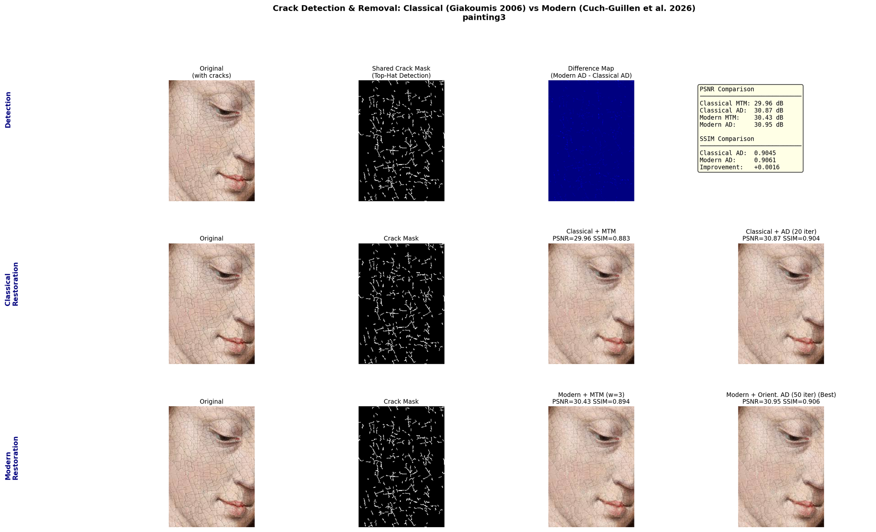
Fig. Comparison Result

Slide 21
Novel Method: Exemplar-Based Patch Inpainting (EBPI)
Proposed method: finds best-matching texture patch from non-crack region
Unlike AD (smooths locally), EBPI copies real texture from similar regions
Limitation: PSNR measured vs cracked original — no ground truth available
EBPI shows visually sharper fills but lower PSNR due to metric limitation

Slide 22
Comparison: Classical vs Modern vs Novel
Key Features | Method | PSNR (dB) | SSIM
Local Diffusion | Classical AD (2006) | 30.87 | 0.9045
Orientation Aware | Modern AD (2026) | 30.95 | 0.90611
Texture patch copy | Novel EBPI | 30.29 | 0.8979
Modern AD consistently outperforms Classical across all 4 paintings.
EBPI trades PSNR for perceptual texture consistency.
All methods use same crack mask comparison is purely inpainting quality.

Slide 23
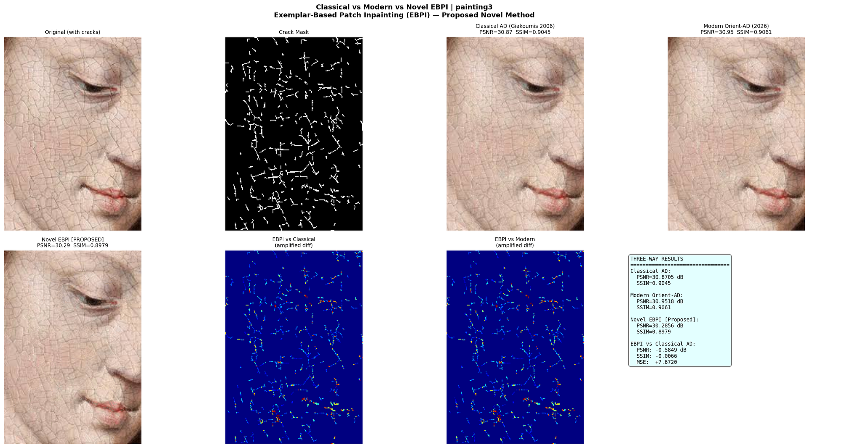
Fig. Threeway Comparison of methods

Slide 24
Thank
You

